Slide 1

Pathplanning and Control in Unity

Slide 2

A Star Pathplanning
It is a Heuristic based algorithm
Finds the optimal path from the starting position to the terminal one
It also handles obstacles

Slide 3
How it works
It needs a discretization (grid) of the environment that can be tought as a maze
Every node (n) of the grid has 3 values
g(n): cost paid strting from the starting node to reach the n-th node
h(n): heuristic cost starting from n-th node to the terminal one. It can be calculated as:
Euclidian distance
Manhattan distance
f(n): sum of the previous two: f(n) = g(n) + h(n)

Slide 4
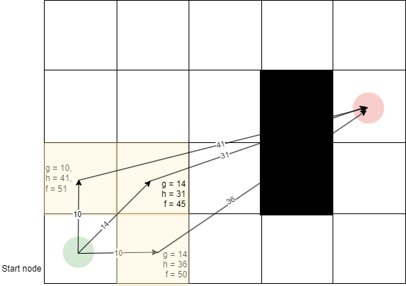
How it works
From the starting node the algorithm checks the collision free neighboors nodes (yellow).
For each of them it calculates the g cost by considering the transition cost as follows:
g(child) = g(parent) + transition_cost
The transition cost depends on the relative position of the two nodes. If they are side by side it’s equal to 10, if they are connected on the diagonal it’s 14
The h cost is calculated for each neighboor node
The f cost is calculated for every neighboor node

Slide 5
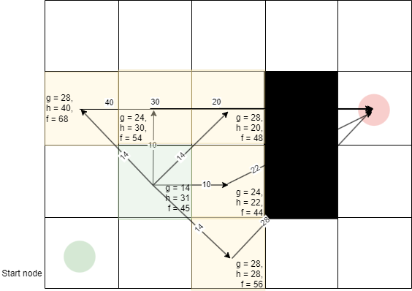
How it works
At the next iteration the process is repeated, but instead of starting from the starting node it starts from the one with lowest f cost

Slide 6
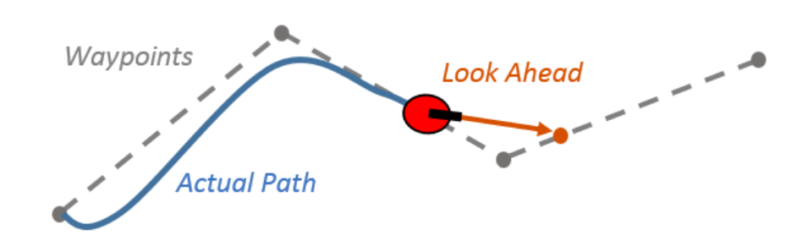
Pure Pursuit Controller
Given the path from the A star algorithm the robot, which in our case it’s a differentiaal drive robot, must be controlled to follow that path
Pure pursuit controller provides an easy and robust way to find out the wheel velocities to perform path tracking

Slide 7
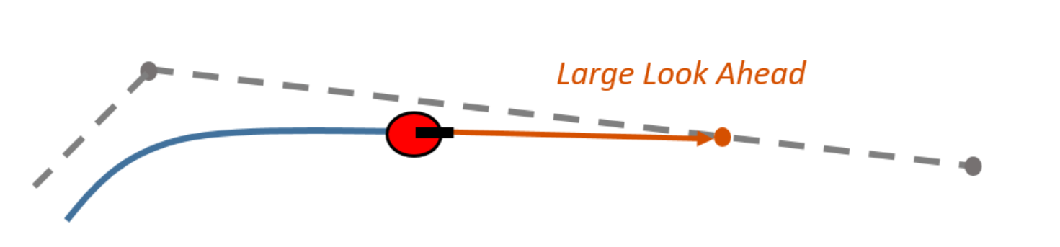
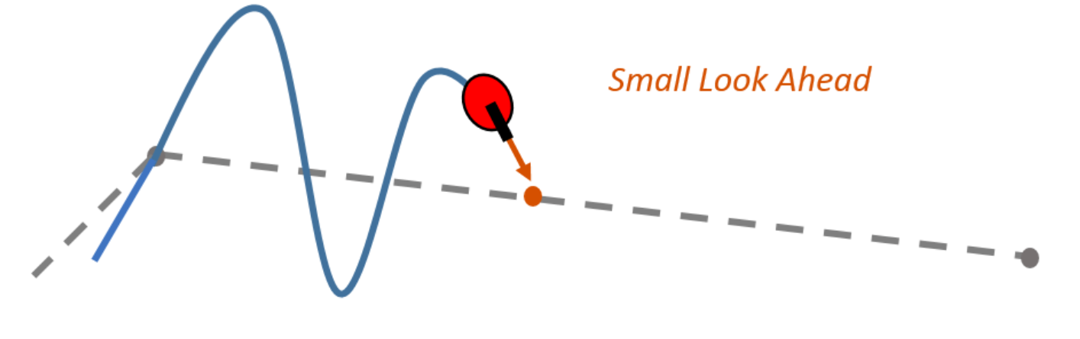
Pure Pursuit Control
Fundamental quantity is Lookahead Distance (LD)
It rules the responsiveness of the control by setting how far away consider the point on the path to be tracke

Slide 8
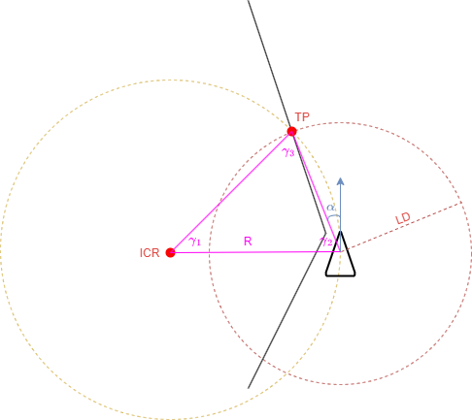
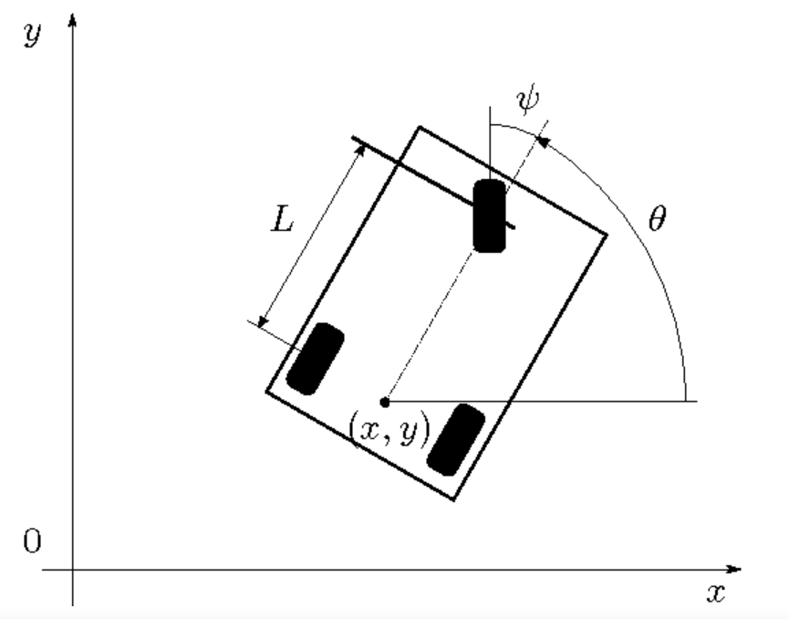


How it works
It finds the radius of curvature by following simple kinematics considerations
Distance from Istantaneous Center of Rotation (ICR) to Target Point (TP) and from ICR to the robot is the same, so ϒ₂ = ϒ₃
From the figure we found ϒ₂ + α = 90°
It follows that ϒ₂ = ϒ₃ = 90 – α, where α is the error angle
Then from law of sines:
$$\frac{LD}{Sin(γ1)}=\frac{R}{Sin(γ2)}$$
Which can be solved for R
Finally we know that the steering angle is linked to R by:
ψ$=arcTan(\frac{L}{R})$

Slide 9
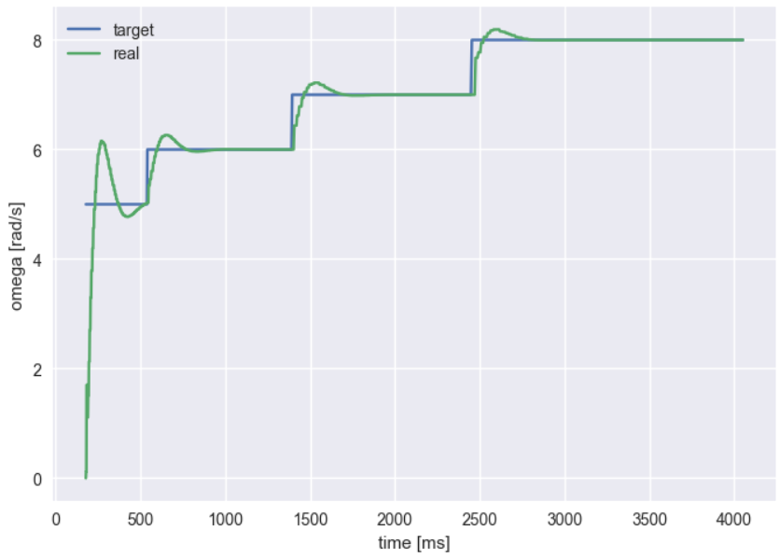
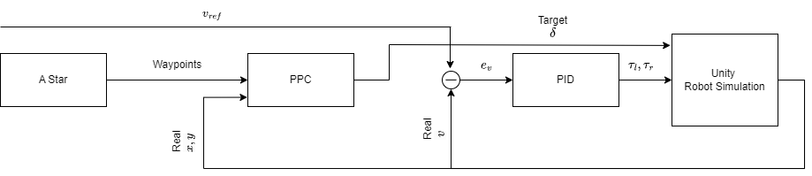
PID
PPC provides target reference steering angle. In Unity one can directly apply that steering without any feedback control.
Instead it is not possible to apply directly a certain rotational speed for the wheels. In order to obtain the desired velocity one has to control the motor torques. Thus a PID controller has been implemented
The Complete system is shown here below

